Slide 1
Message Training
October 29, 2014

Slide 2
Our New Logo and Tagline

Slide 3
Our New Look and Feel

Slide 4
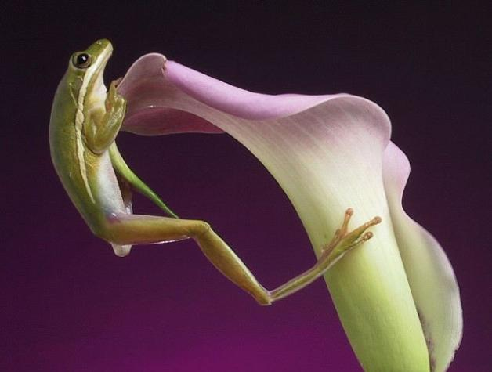
This Brand Won’t Work Without You
Sed ut perspiciatis

Slide 5
Bringing the Brand to Life
Know the Key Messages
Be prepared to answer: So, what does Plant Select® do?
Be Proactive
Decide what’s relevant to your audience
Make it Personal
Enhance with your personal observations
Make It Powerful
Demonstrate enthusiasm
Notes:
5

Slide 6
What You’ll Be Learning in this presentation
What, How, Why Plant Select®?
Techniques for delivering the message and adding emotion and power
Storytelling as a powerful technique

Slide 7
Messaging Level #1: Who Is Plant Select®? What makes us different? Why do we matter?

Slide 8
Who We Are:
Plant Select ® is the country’s leading source of plants designed to thrive in high plains and intermountain regions.
Key phases:
- Leading source of plants
- Thrive in high plains and
intermountain regions

Slide 9
What We Do
We find, test and distribute plants that help gardeners create smart, stunning successful gardens in tough environments
Key words:
-Find
-Test
-Distribute

Slide 10
What Makes Us Unique?
FOUR things make Plant Select®
unique:
A Smart Model
A Smart 7-Point Selection Process
Smart Features
Smart Benefits

Slide 11
Smart Model
Our smart, collaborative model leverages the power of
three entities:
Colorado State University
Denver Botanic Gardens
Horticultural industry professionals locally, nationally and globally.

Slide 12
Smart Process
Our 7-point selection processes:
THRIVE IN BROAD RANGE OF CONDITIONS
FLOURISH WITH LESS WATER
TOUGH and RESILIENT IN CHALLENGING CLIMATES
ONE OF A KIND/UNIQUE
DISEASE/INSECT RESISTANCE
LONG-LASTING BEAUTY
NON-INVASIVE

Slide 13
Smart Features
Beautiful
Adaptable
Durable
Water-Wise
Easy to Care For
Lower environmental impact
Tough and Beautiful at the same time

Slide 14
Smart Benefits
Right plants for the right climate means more chance of success
Environmentally-smart garden
More garden beauty with less work
Gardens that flourish longer with less resources
Gardens that can save time and money

Slide 15
Why We Matter -Bottom-Line Benefit
With Plant Select®, gardeners of all levels – from neglectful, novice and master gardeners to industry
professionals can have
SMART, STUNNING and
SUCCESSFUL plants using fewer resources and with a positive environmental impact.

Slide 16
Messaging Level #2: What’s Your Story?

Slide 17
Becoming Brand Ambassadors
Everyone connected with Plant Select®
has a story to tell that relates to:
How Plant Select® Helps You
Plant Smarter
What’s your story?
Can you tell a story or give an example of how Plant Select® helped you, a customer, a grower, a retailer, or a gardener Plant Smarter?

Slide 18
How Can You Help?
Be our brand ambassador
Train other folks on the message
Use this PowerPoint
We can send messaging materials, buttons
Identify opportunities to promote Plant Select®
THANK YOU!

